Slide 1
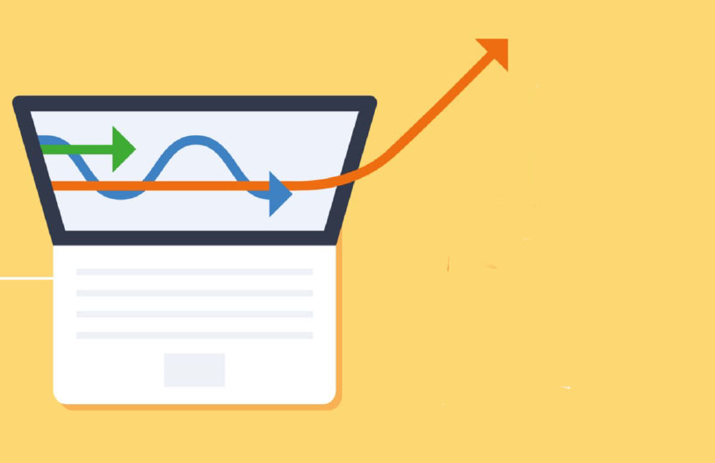
Marketing Analytics Certificate
Use data to provide insights to marketing decision makers
High demand for graduates with marketing analytics skills
Spring semester courses:
Mrktng 4900, Analyzing Business Data
Mrktng 4920, Data Visualization (Tableau)
Mrktng 4950, Data-Based Decision Making
Questions? contact marketinganalytics@missouri.edu

